Slide 1

Mid Semester Review
Justin Le
SWARM EX COMMs
Justin Le
SWARM EX COMMS Mid Semester Review
Fall 2026
Notes:
I'm Justin Le, the COMMs lead for SWARM-EX this semester. This review covers my original plan, how the tests build on each other, what I've done so far, my schedule for the rest of the semester, the impact on the team, and the risks I'm tracking.
Most of my work is aimed at getting SCT and CET ready for the SWARM-EX Pre-Integration Review in early 2027.

Slide 2
Original Plan and Milestones
COMMs Lead for the semester
  managing and tracking COMMs work
  monitoring ground station bring-up
Work towards Simulated Comms Test (SCT) 2 with Lithium 2 radio and Software Defined Radio in the loop
  Re-running Minimum Communication Test
  Re-running SCT-1
  Running SCT-2
Setting up Ground Station PC
  implementing 2 machines, one Windows for Hydra, one Ubuntu 16 for GNU Radio
  verifying the setup in the Ground Station Chain
Personal goals
Develop in Hydra
Develop in MPLAB for CDH
Understand the packet chain end to end for the Lithium
Embedded software skills
Scope and track team work
Justin Le
SWARM EX COMMS Mid Semester Review
Fall 2026
Notes:
At the start of the semester my plan had three parts. As COMMs lead I'd manage and track COMMs work and monitor the ground station bring-up. On the technical side I'd work toward SCT-2, with the Lithium-2 radio and the software defined radio in the loop, by re-running MCT, re-running SCT-1 and then running SCT-2. I'd also set up the ground station PC as two machines, one Windows machine for Hydra and one Ubuntu 16 machine for GNU Radio, and verify that setup in the ground station chain.
The milestones from my first quad chart were re-running MCT by 9/21, testing the GS PC by 9/23, re-running SCT-1 by 9/30 and running SCT-2 by 10/31, with SCT-3 and CET as stretch goals.
My personal goals were to get comfortable developing in Hydra, understand the packet chain end to end, build embedded debugging skills, and get better at scoping and tracking work for a team.

Slide 3
How the tests build on each other
MCT
Hydra → CDH →
Li-2 over UART
SCT-1
CDH ↔ Hydra hardwired
SCT-2
Adds the Li-2 and SDR, decoded through GNU Radio into Hydra
SCT-3
Adds the antennas, over a short range
SCT-4
Same setup, over a long range
Each test adds to the one before it, working toward CET and DITL. The next five slides show each test setup.
Justin Le
SWARM EX COMMS Mid Semester Review
Fall 2026
Notes:
Each test adds to the one before it. MCT sends commands from Hydra through CDH to the Li-2 over UART. SCT-1 hardwires CDH and Hydra. SCT-2 adds the Li-2 and the SDR, with the signal decoded through GNU Radio into Hydra. SCT-3 adds the antennas over a short range, and SCT-4 is the same setup over a long range.
All of it works toward CET and DITL. The next five slides show each test setup.

Slide 4
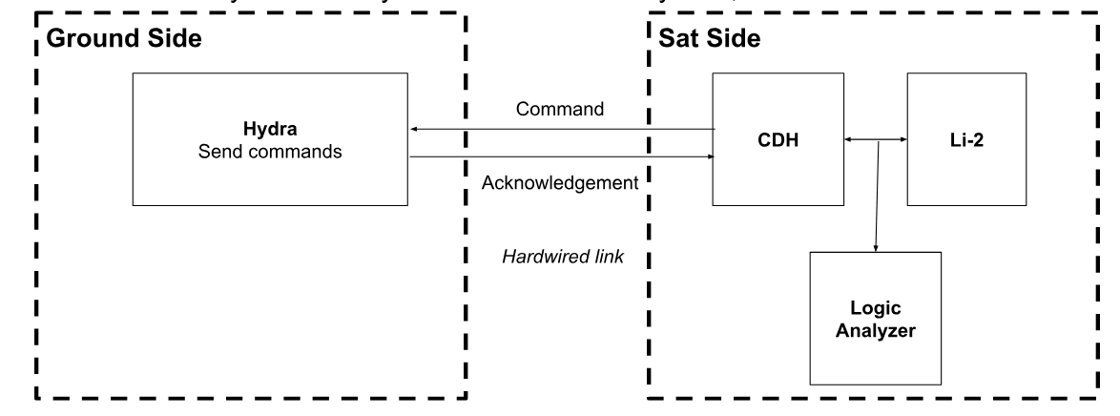
MCT: Hydra → CDH → Li-2 over UART
Verifies commands from Hydra reach the Li-2 through CDH and are acknowledged. A logic analyzer on the UART lines checks the no-op, transmit and reset commands.
Justin Le
SWARM EX COMMS Mid Semester Review
Fall 2026
Notes:
In MCT, Hydra on the ground side sends commands to CDH over a hardwired link, CDH passes them to the Li-2, and the acknowledgments come back to Hydra.
A logic analyzer on the UART lines between CDH and the Li-2 checks the no-op, transmit and reset commands.

Slide 5
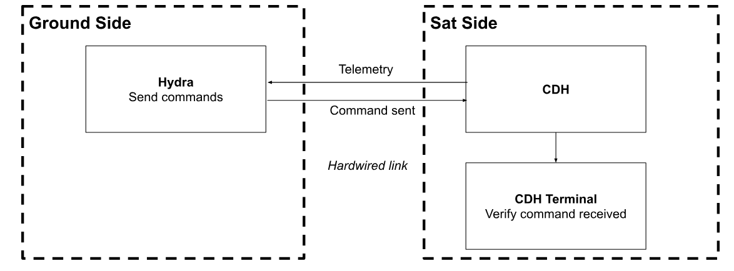
SCT-1: Hardwired CDH and Hydra
Verifies CDH reads Hydra’s command bytes and Hydra reads CDH’s telemetry bytes, with no wireless link. Hydra requests a housekeeping packet, the CDH terminal confirms the command arrived, and the packet shows up in Hydra telemetry.
Justin Le
SWARM EX COMMS Mid Semester Review
Fall 2026
Notes:
SCT-1 checks the hardwired link between CDH and Hydra, without wireless communication as a factor. The point is that CDH correctly reads the command bytes coming from Hydra, and Hydra correctly reads the telemetry bytes coming back from CDH.
Hydra sends a command requesting a housekeeping packet, the CDH terminal confirms the command arrived, and then the packet shows up in Hydra telemetry.

Slide 6
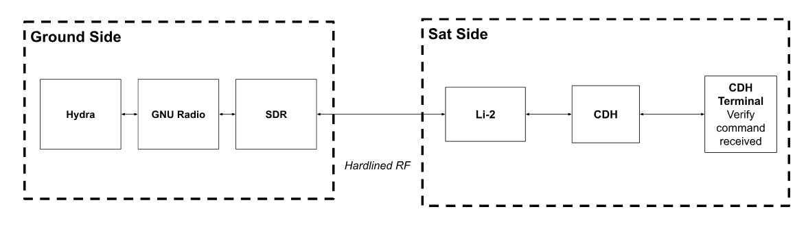
SCT-2: Full chain, antenna out of the loop
Verifies a message can go both ways through Hydra, GNU Radio, the SDR, the Li-2 and CDH. The SDR and Li-2 are connected by a hardline instead of antennas.
Justin Le
SWARM EX COMMS Mid Semester Review
Fall 2026
Notes:
SCT-2 runs the whole chain with only the antenna out of the loop. A message goes through Hydra, GNU Radio and the SDR on the ground side, over a hardlined RF connection to the Li-2, and on to CDH, with the CDH terminal confirming the command was received.
The point is to show a message can be sent in both directions through the hardware and software.

Slide 7
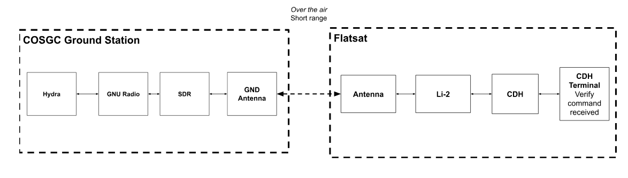
SCT-3: Antennas in the loop, short range
Verifies antenna and ground station performance and closing the link. The flatsat goes to the parking garage across from the DLC, and the SWARM-EX Hydra and GNU Radio instances run in the COSGC Ground Station.
Justin Le
SWARM EX COMMS Mid Semester Review
Fall 2026
Notes:
SCT-3 adds the antennas over a short range. The flatsat goes to the parking garage across from the DLC, and the SWARM-EX Hydra and GNU Radio instances run in the COSGC Ground Station, with the ground antenna talking to the flatsat antenna over the air.
The point is to verify antenna and ground station performance and that we can close the link.

Slide 8

SCT-4: Antennas in the loop, long range
Same setup as SCT-3. Only the distance between the flatsat and the ground station changes, to verify the link closes over a longer range.
Justin Le
SWARM EX COMMS Mid Semester Review
Fall 2026
Notes:
SCT-4 is the same setup as SCT-3. The only difference is a longer distance between the flatsat and the ground station, to check antenna and ground station performance and that the link still closes over a longer range.

Slide 9
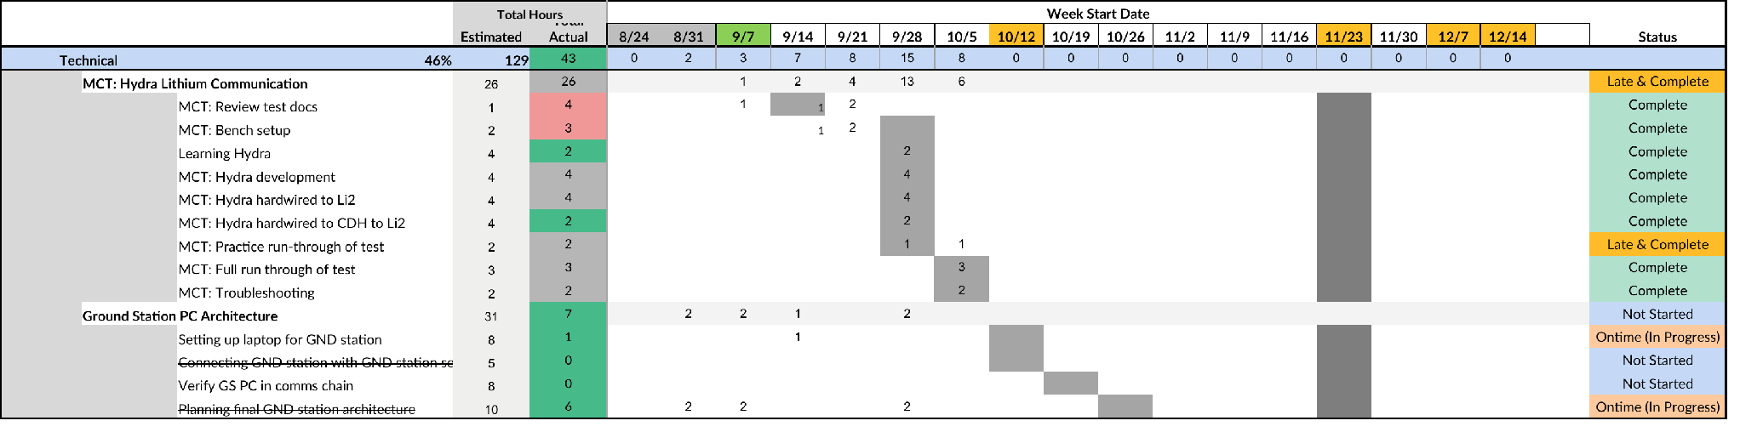
Changes to the plan
Start of semester
I was developing the GS PC architecture that will be implemented
Rick's 2-PC proposal to mitigate hydra crashes
The 443 white tower running Hydra, plus GS laptop running GNU Radio
Currently
Scott Palo and Nicholas Rainville lead GS PC development and bring-up
My role is verifying it in the comms chain once it works
Blocked on development and no ground station licensing for a while
Justin Le
SWARM EX COMMS Mid Semester Review
Fall 2026
Notes:
The plan changed early on. At the start of the semester I was developing the GS PC architecture that would be implemented. Rick proposed a two-PC setup, and I proposed the 443 white tower running Hydra plus a ground station laptop running GNU Radio.
Now Scott Palo and Nicholas Rainville lead GS PC development and bring-up, and my role is verifying it in the comms chain once it works. That's blocked on their development for now, and we won't have ground station licensing for a while.
The waterfall excerpt shows the change. The MCT rows are complete, and the GS PC setup rows are struck through since they're no longer mine.

Slide 10
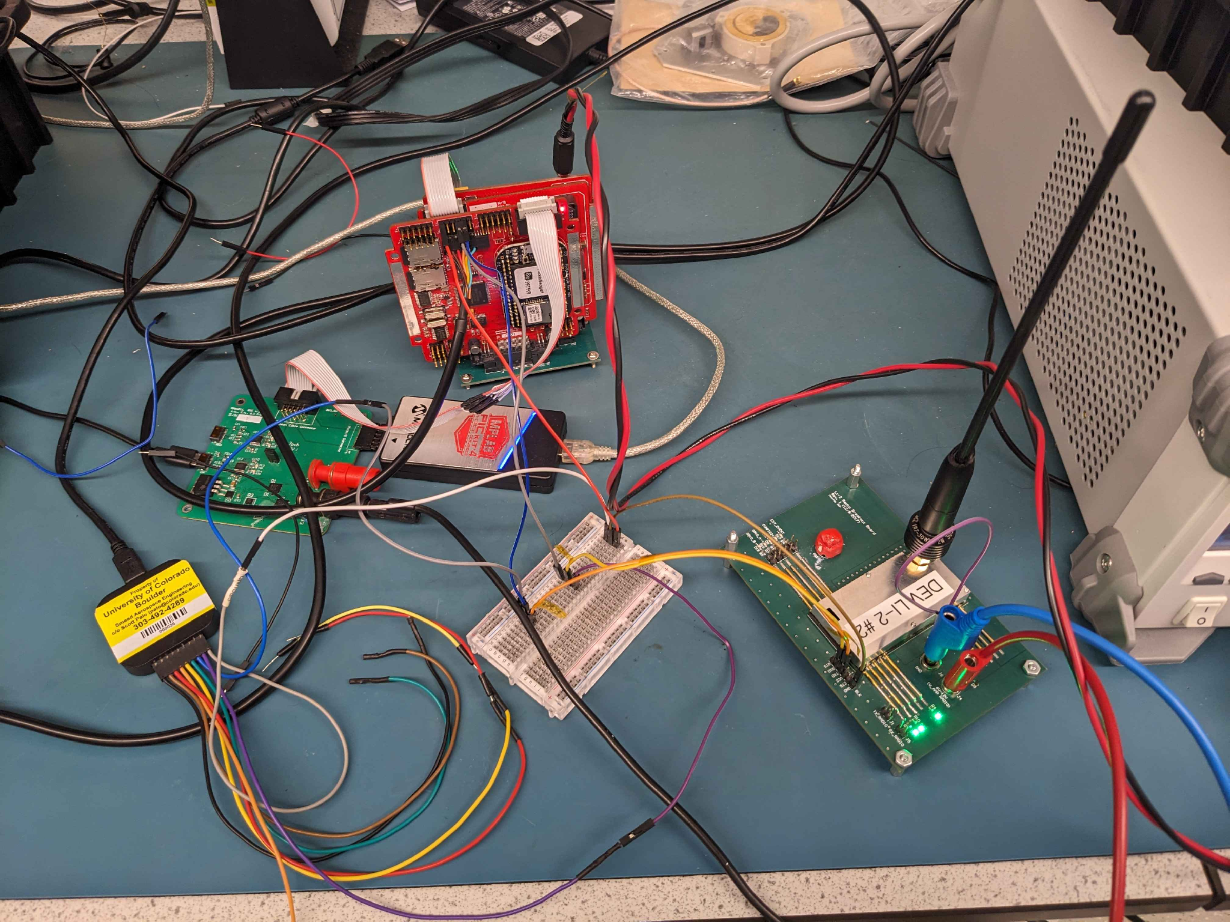
Minimum Communications Test
Worked bottom up, one interface at a time
1. Added the Li-2 commands, states and an opcode dictionary to Hydra
2. Hardwired Hydra straight to the Li-2 and confirmed no-op, transmit and reset on the logic analyzer
Took longer than planned from documentation gaps and getting familiar with the hardware and software
3. Put the CDH board in the loop. Commands were sent and acknowledged properly
Result: commands acknowledged through
Hydra → CDH → Li-2
Justin Le
SWARM EX COMMS Mid Semester Review
Fall 2026
Notes:
Moving onto technical accomplishments, MCT is my main technical result so far. I worked bottom up, one interface at a time. First I added the Li-2 commands, states and an opcode dictionary to Hydra. Then I hardwired Hydra straight to the Li-2 and confirmed no-op, transmit and reset on the logic analyzer. That step took longer than planned because of documentation gaps and getting familiar with the hardware. Last, I put the CDH board in the loop, and the commands were sent and acknowledged properly.
The result is that commands are acknowledged through Hydra, CDH and the Li-2. The photo is the bench setup I used.

Slide 11
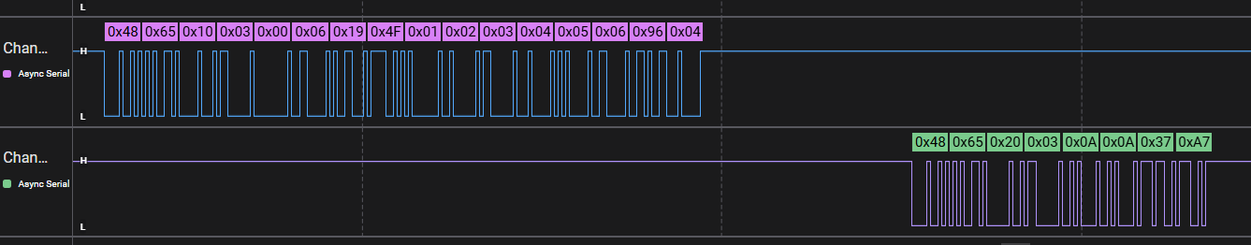
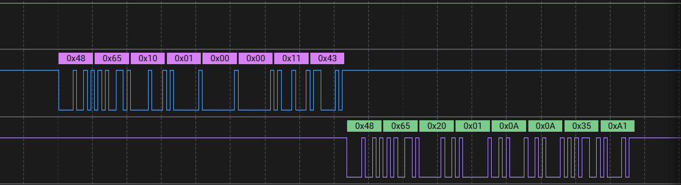
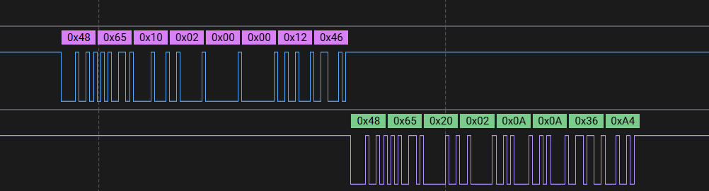
MCT: logic analyzer captures
Top trace: command sent to the Li-2. Bottom trace: the Li-2’s reply
Transmit (0x03) with a payload
No-op (0x01)
Reset (0x02)
Justin Le
SWARM EX COMMS Mid Semester Review
Fall 2026
Notes:
These are the logic analyzer captures from MCT. In each one, the top trace is the command going to the Li-2 and the bottom trace is the Li-2's reply.
The transmit command carries a 6-byte payload, and the no-op and reset commands have none. Every reply ends in 0x0A 0x0A, the Li-2's acknowledgment, so all three commands were received and acknowledged.

Slide 12
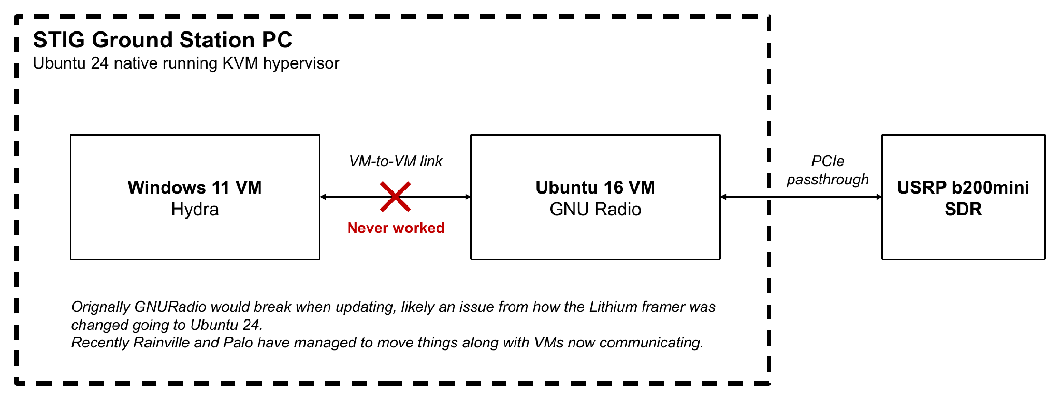
Ground Station PC
Created a STIG GS PC status doc
Covers the current setup, why it was built that way, the issues, who is involved, options and open questions. It became the shared picture for Palo, Rainville, and the MAXWELL and SWARM-EX COMMs teams.
Issues at start of the semester
The VMs can’t talk to each other
VPN problems
Our GNU Radio file can’t run natively on Ubuntu 24
There has been recent development and it can communicate with the SDR both ways
Verification
1. USRP → GNU Radio
2. GNU Radio ↔ Hydra
3. The whole ground side with the station hardware
Justin Le
SWARM EX COMMS Mid Semester Review
Fall 2026
Notes:
For the ground station PC, I created a status doc on the STIG GS PC. It covers the current setup, why it was built that way, the issues, who's involved, the options and the open questions, and it became the shared picture for Palo and the MAXWELL and SWARM-EX COMMs teams.
The diagram shows the setup: an Ubuntu 24 host running KVM, with a Windows 11 VM for Hydra, an Ubuntu 16 VM for GNU Radio, and the USRP b200mini passed through to the GNU Radio VM. At the start of the semester the VMs couldn't talk to each other, there were VPN problems, and our GNU Radio file couldn't run natively on Ubuntu 24. GNU Radio would break when updating, likely because of how the Lithium framer changed going to Ubuntu 24. Recently Rainville and Palo got the VMs communicating.
Once the PC is ready, I'll verify it bottom up: USRP to GNU Radio, then GNU Radio to Hydra, then the whole ground side with the station hardware.

Slide 13
Lead work
Team
Onboarded Edin, Elsa, Atharv and Ian
Elsa working on satellite tracking
Edin working on ground station bring up
Gave Atharv the SWARM-EX and ground station block diagrams
Gave Ian the SCT documents for the SCT procedures
Tracking
Tracking action items from the whole team along with ongoing issues
Weekly quad charts for COMMs as a whole and a Gantt chart
Managing blockers, dependencies, and rescheduling tasks for the team
Coordination
Skye (MAXWELL)
Alex Burns (former MAXWELL COMMs lead)
Dhruva (former SWARM EX COMMs lead)
Scott Gennari (LASP)
Justin Le
SWARM EX COMMS Mid Semester Review
Fall 2026
Notes:
As lead, I onboarded Edin, Elsa, Atharv and Ian. Elsa is working on satellite tracking and Edin on ground station bring-up. I gave Atharv the SWARM-EX and ground station block diagrams, and gave Ian the SCT documents for the SCT procedures.
I track action items from the whole team along with ongoing issues, put together weekly quad charts for COMMs as a whole and a Gantt chart, and manage blockers, dependencies and rescheduling.
I coordinate with Skye on MAXWELL, Alex Burns as the former MAXWELL COMMs lead, Dhruva as the former SWARM-EX COMMs lead, and Scott Gennari at LASP.

Slide 14
Schedule
SCT-1
10/16 – 10/22
Bench setup 10/16, practice run 10/19, full run 10/20–10/21, troubleshooting 10/22
GS PC verification
10/30 – 11/6
Once Palo and Rainville are ready to transfer to COSGC. Meanwhile, update GNU Radio and check its state for SCT-2
SCT-2
10/26 – 12/3
Procedure review 10/23, Hydra dev 10/27–11/2, practice 11/13, full run 11/17–11/20
Wrap-up
Weeks of 12/7 and 12/14
End-of-semester review, transition document and final report
Milestone | Planned | Now
Re-run MCT | 9/21 | Done 10/8
GS PC test | 9/23 | 10/30 – 11/6
Re-run SCT-1 | 9/30 | 10/20
SCT-2 | 10/31 | 11/17 – 11/20
Justin Le
SWARM EX COMMS Mid Semester Review
Fall 2026
Notes:
SCT-1 runs 10/16 to 10/22: bench setup on 10/16, a practice run on 10/19, the full run 10/20 to 10/21, and troubleshooting on 10/22.
GS PC verification is planned for 10/30 to 11/6, once Palo and Rainville have it working. In the meantime I'll update GNU Radio and check its state for SCT-2.
SCT-2 runs 10/23 to 12/3: the procedure review on 10/23, Hydra development 10/27 to 11/2, a practice run on 11/13 and the full run 11/17 to 11/20. The weeks of 12/7 and 12/14 are for the end-of-semester review, the transition document and the final report.
Compared to the original plan, MCT finished on 10/8 instead of 9/21, the GS PC test moved from 9/23 to 10/30 through 11/6, SCT-1 moved from 9/30 to 10/20, and SCT-2 moved from 10/31 to 11/17 through 11/20.

Slide 15
SWARM EX Impact
OnSat Comms
Li-2 - CDH comms state was unclear
Earlier semesters ran MCT and SCT but never reached SCT-2
Re-verifying MCT and SCT gives a clear starting point for SCT-2
Ground station PC
Long-running pain point for COMMs
STIG doc turned it into an issue list that can be addressed
Palo and Rainville bringing it up, needed for MAXWELL’s February launch
COMMs lead
Manage the tasks COMMs needs for SWARM-EX
Team work tracked week to week
Blockers addressed and routed to the right person (other subsystems, Palo, LASP, MAXWELL)
Justin Le
SWARM EX COMMS Mid Semester Review
Fall 2026
Notes:
The state of comms between the Li-2 and CDH was unclear. Earlier semesters ran MCT and SCT but never reached SCT-2, so re-verifying MCT and SCT gives us a clear starting point for SCT-2.
The ground station PC has been a long-running pain point for COMMs. The STIG doc turned it into an issue list with clear owners, and Palo and Rainville bringing it up is needed for MAXWELL's February launch.
As COMMs lead I manage the tasks COMMs needs for SWARM-EX, track the team's work week to week, and route blockers to the right person, whether that's CDH, Palo, LASP or MAXWELL.

Slide 16
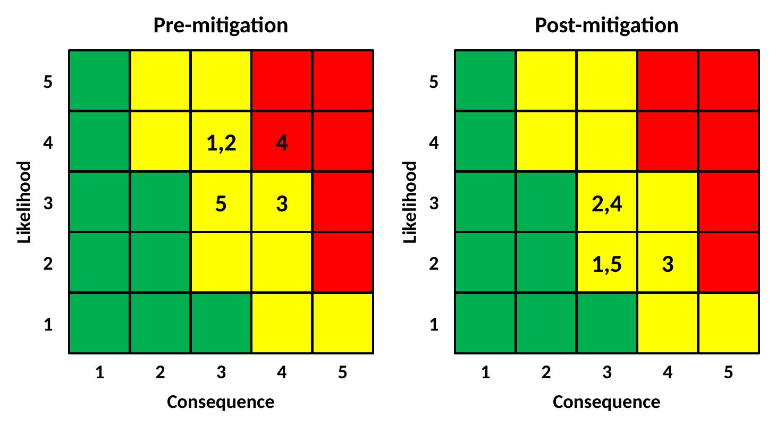
Risks and Concerns
1. SCT-1 is delayed, which delays SCT-2
Mitigation: prep SCT-2 in parallel (procedure reviews, GNU Radio development) while SCT-1 finishes
2. SCT-2 needs more development than planned
Mitigation: reaching out to Dhruva, Palo, or MAXWELL for support
3. Motor interface can’t be resolved or bypassed
Mitigation: Elsa is looking into working with Palo and getting help from LASP
4. Delays in ground station bring-up
Mitigation: Allocating more people and time to focus more on the ground station
5. Issues verifying the GS PC at COSGC
Mitigation: verify bottom up, with the interim laptop as a fallback
Justin Le
SWARM EX COMMS Mid Semester Review
Fall 2026
Notes:
These are the risks I'm tracking, rated by consequence and likelihood before and after mitigation. Before mitigation, delays in ground station bring-up are in the red and the rest are in the yellow. After mitigation, all five are in the yellow.
One, SCT-1 is delayed, which delays SCT-2, so I'm prepping SCT-2 in parallel, with procedure reviews and GNU Radio development, while SCT-1 finishes. Two, SCT-2 may need more development than planned, so I'll scope the Hydra work at the 10/23 procedure review and reuse the MCT and SCT-1 work.
Three, the motor interface might not get resolved or bypassed. Elsa is looking into working with Palo and getting help from LASP. Four, ground station bring-up could slip, so we can run verification in the chain with the interim laptop setup from MAXWELL. Five, verifying the GS PC at COSGC could run into issues, so I'll verify bottom up with the interim laptop as a fallback.

Slide 17
Thank you
Notes:
That's my mid-semester review. Thanks for watching.

